Slide 1
Pablo Picasso

Slide 2
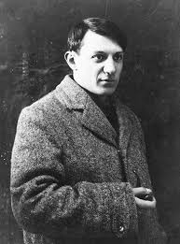
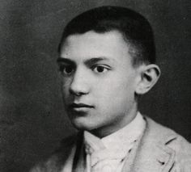
Fact #1
Pablo Picasso was born on the 25th of October 1881 in Màlaga, Spain and died on 8th April 1973 in Mougins, France.

Slide 3
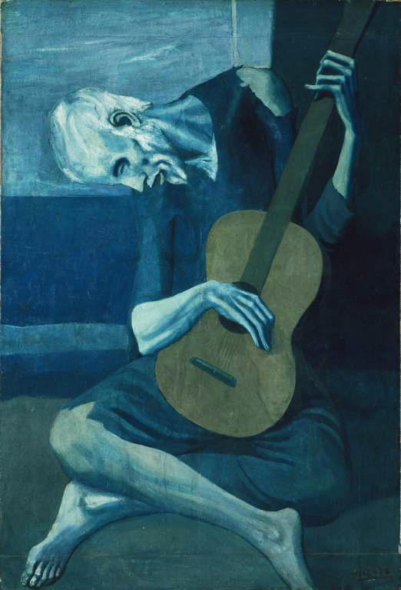
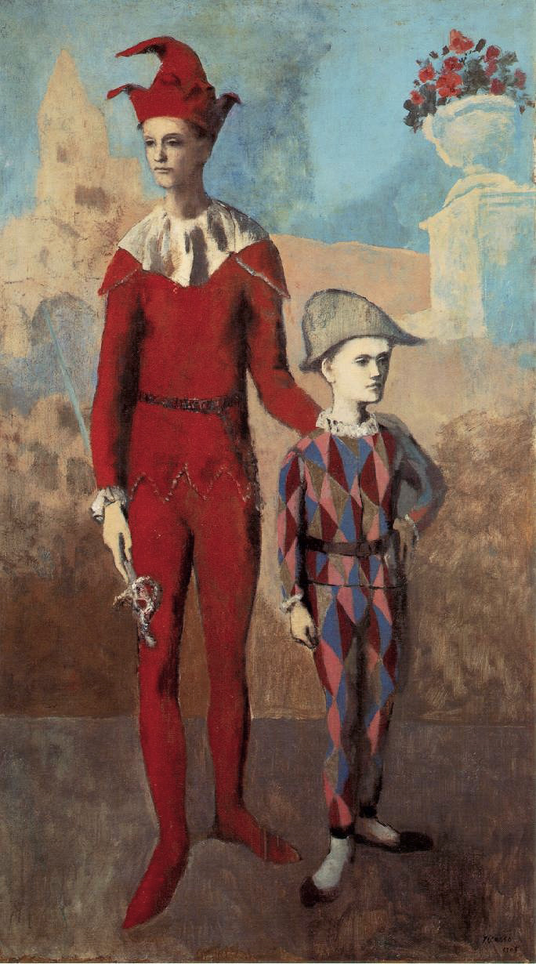
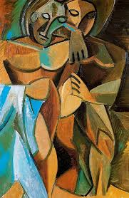
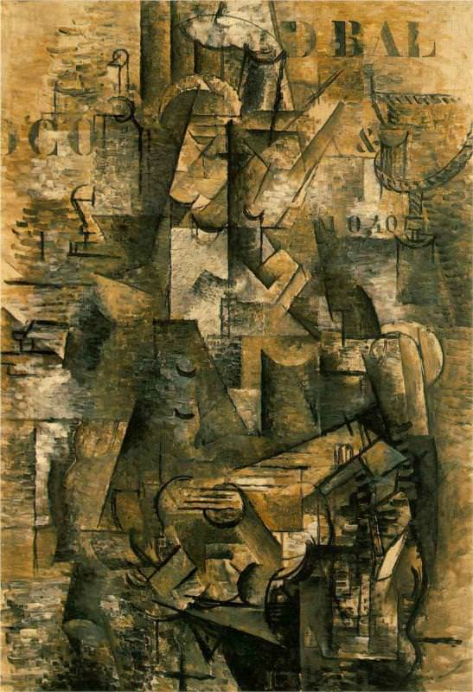
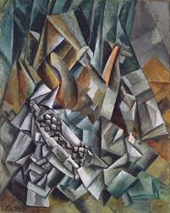
Fact #2
He had five different periods of his life in which he painted and sculpted in different styles. These periods were called the Blue Period, the Rose Period, the African-influenced Period, the Cubism Period and the Crystal Period.

Slide 4
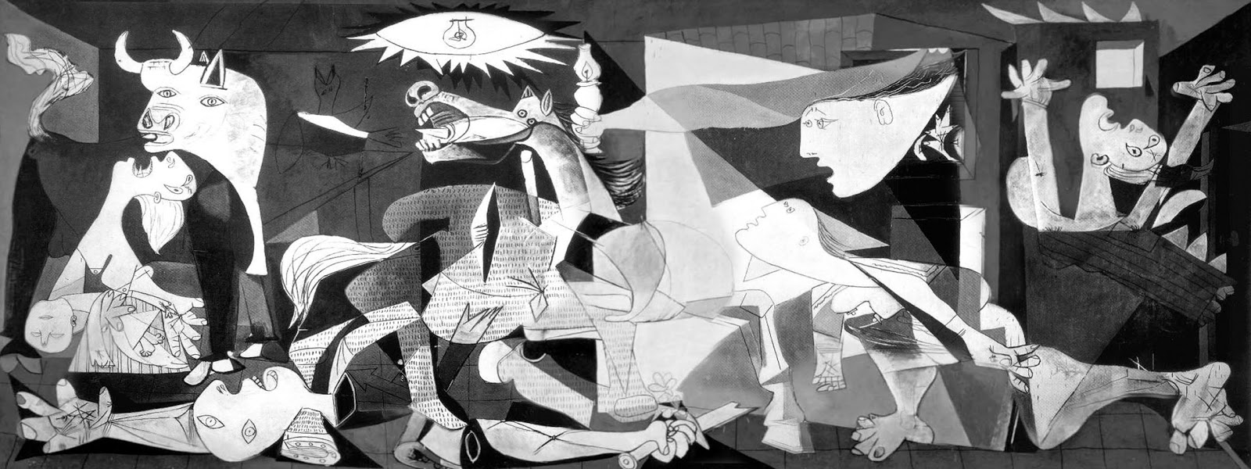
Fact #3
During the Spanish Civil War a town called Guernica was bombed by German bombers. Pablo Picasso painted a picture about the carnage. It’s called Guernica and it is one of Picasso’s most famous paintings.

Slide 5
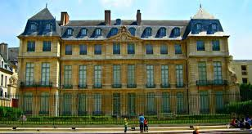
Fact #4
The total number of artworks that he produced is around 50,000. He did 1,885 paintings, 1,228 sculptures, 2,880 ceramics, roughly 12,000 drawings, many thousands of prints, and numerous tapestries and rugs. They are all stored in the Musèe Picasso in Paris.

Slide 6
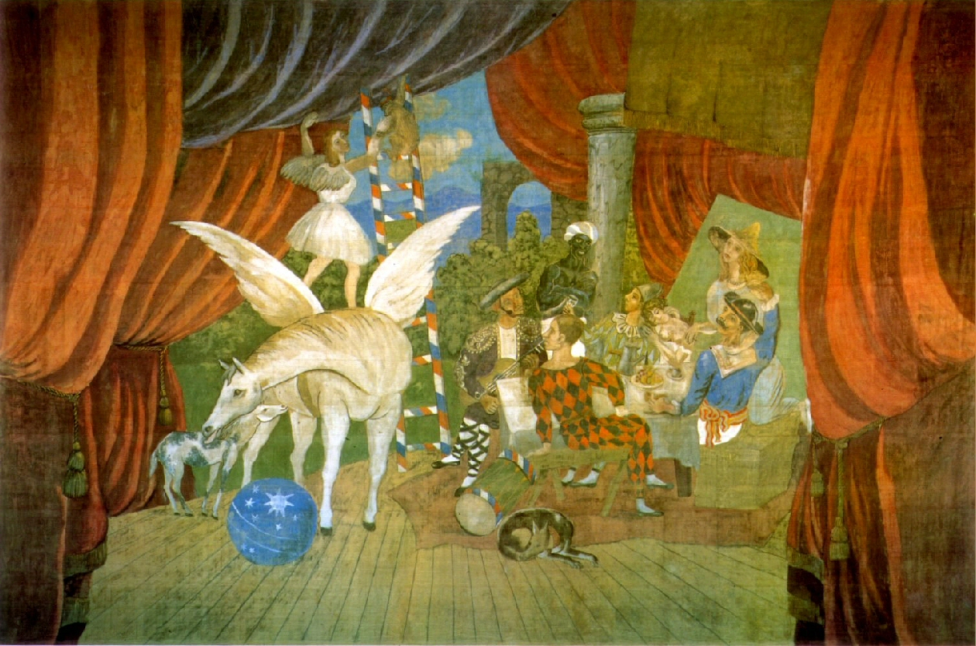
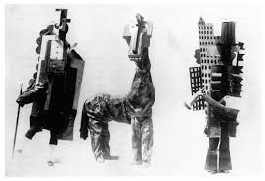
Fact #5
Pablo Picasso’s biggest piece of art was a curtain for the ballet “Parade”. He also helped to design the costumes for it too.

Slide 7
Credits
Author: Conor O’Donohoe
Editor: Conor O’Donohoe, Carol O’Donohoe, Darren O’Donohoe
Pictures: Google Images
PC: HP Stream
Thanks!

